Slide 1
Mod 4 Mesh Network
Wireless Mesh Networks
By Ian Akyildiz, Xudong Wang

Slide 2
MESH NETWORK?
The term 'wireless mesh networks' describes wireless networks in which each node can communicate directly with one or more peer nodes.(Bridge to bridge communication)
The term 'mesh' originally used to suggest that all nodes were connected to all other nodes, but most modern meshes connect only a sub-set of nodes to each other.
Nodes are comprised of mesh routers and mesh clients.
A WMN is dynamically self-organized and self configured (adhoc ), with the nodes in the network automatically establishing and maintaining mesh connectivity among themselves.

Slide 3
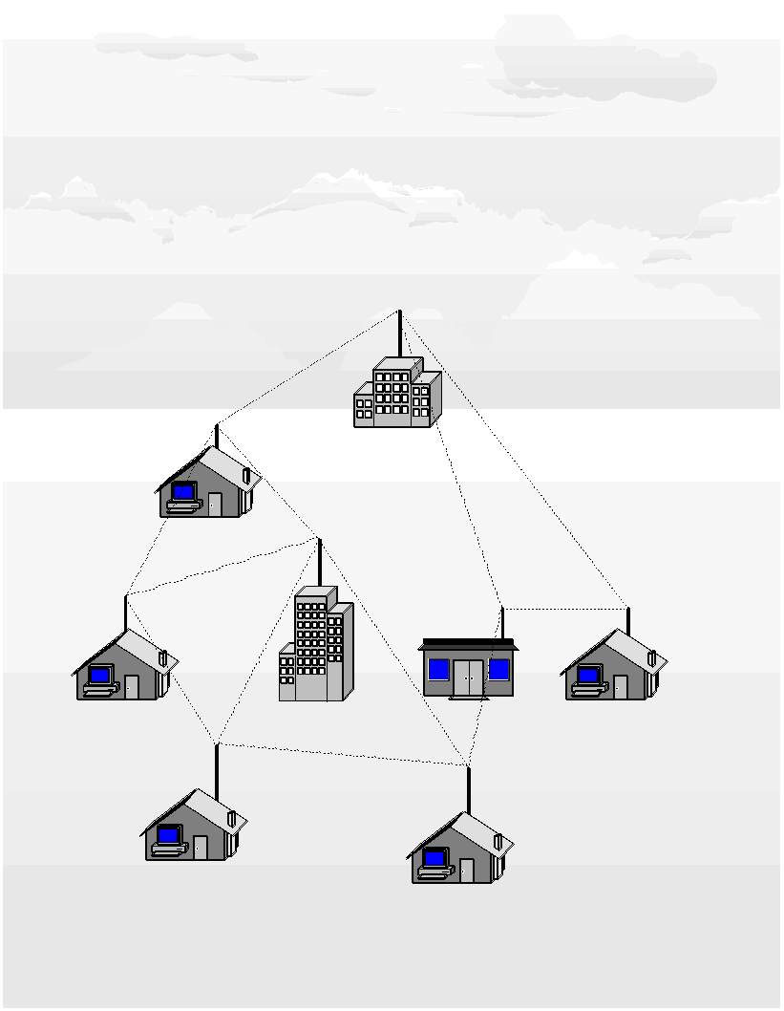

Slide 4
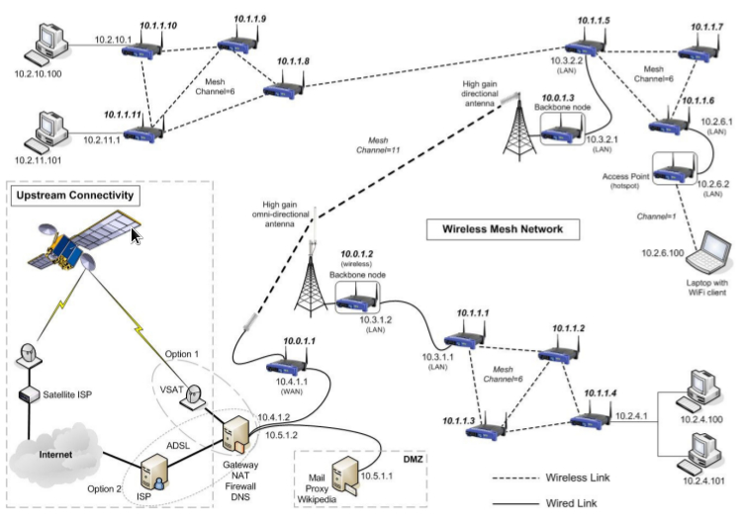

Slide 5
NECESSITY FOR MESH NETWORKS
There is a need of the network with following features
Using fewer wires means it costs less to set up a network, particularly for large areas of coverage.
The more nodes you install, the bigger and faster your wireless network becomes.
Rely on the same WiFi standards already in place for most wireless networks.
Convenient where Ethernet wall connections are lacking -- for instance, in outdoor venues, warehouses or transportation settings.

Slide 6
Networks of "self configuring;" the network automatically incorporates a new node into the existing structure without needing any adjustments by a network administrator.
Networks of "self healing," since the network automatically finds the fastest and most reliable paths to send data, even if nodes are blocked or lose their signal.
Nodes are easy to install and uninstall, making the network extremely adaptable and expandable as more or less coverage is needed.

Slide 7
CHARACTERISTICS OF WIRELESS MESH NETWORKS
Multi-hop WMN:
Need to extend the coverage
To provide greater coverage and non-line-of-sight (NLOS) among nodes, the multi-hop function becomes indispensable.
Support for ad hoc networking, and capability of self forming, self healing, and self-organization:
Adhoc networking enhances n/w performance , flexible network architecture, easy deployment and configuration.
So WMNs require less initial cost.
Mobility dependence on type of mesh nodes:
Minimal mobility of mesh routers but mesh clients can be stationary or mobile nodes.

Slide 8
CHARACTERISTICS OF WIRELESS MESH NETWORKS
Multiple types of network access:
WMNs can support backhaul access to the Internet and peer-to- peer communications.
backhaul means getting data to a point from which it can be transmitted to the satellite
Dependence of power-consumption constraints on the type of mesh nodes:
Mesh clients require power efficient protocols in contrast to mesh routers.
Compatibility and interoperability with existing wireless networks:
WMNs built based on IEEE 802.11 technologies have to be compatible with the other IEEE standards.
Additionaly, such networks must be inter-operable with other types of wireless networks, e.g. WiMAX, ZigBee and cellular networks.

Slide 9
ARCHITECTURE OF WMNs.
Three different categories distinguish in the WMNs architecture, based on the functionality of the nodes.
Infrastructure/backbone WMNs
Client WMNs
Hybrid WMNs

Slide 10
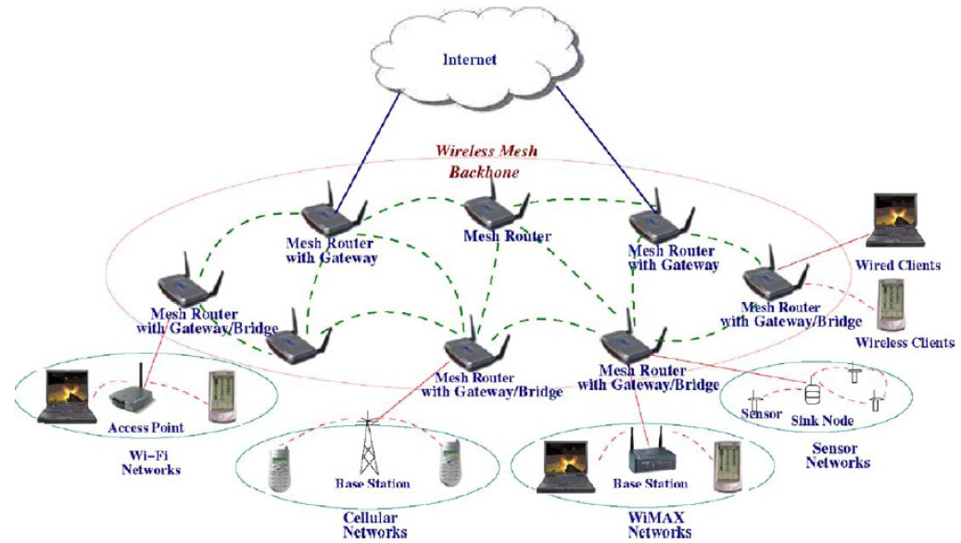
Infrastructure/backbone WMNs

Slide 11
The dashed and solid lines denote wireless and wired connections
Different kinds of clients connect to the mesh routers that form the infrastructure.
Type of radio technology used by the mesh routers – 802.11
Routers apply self configuring, self-healing links among themselves to form the backbone network.
Clients can connect to the mesh routers either by using the Ethernet interface or by using the same radio technology as the routers.
Provide integration of WMN with existing wireless technologies using Gateway mesh router

Slide 12
Client WMNs

Slide 13
In this type of architecture, no mesh router exists.
Instead, conventional devices establish peer-to-peer networks among them to constitute the actual network performing routing and configuration functions as well as providing end-user applications to customers.
There exists one single radio interface among the devices and a packet is forwarded to its destination by hopping through devices.

Slide 14
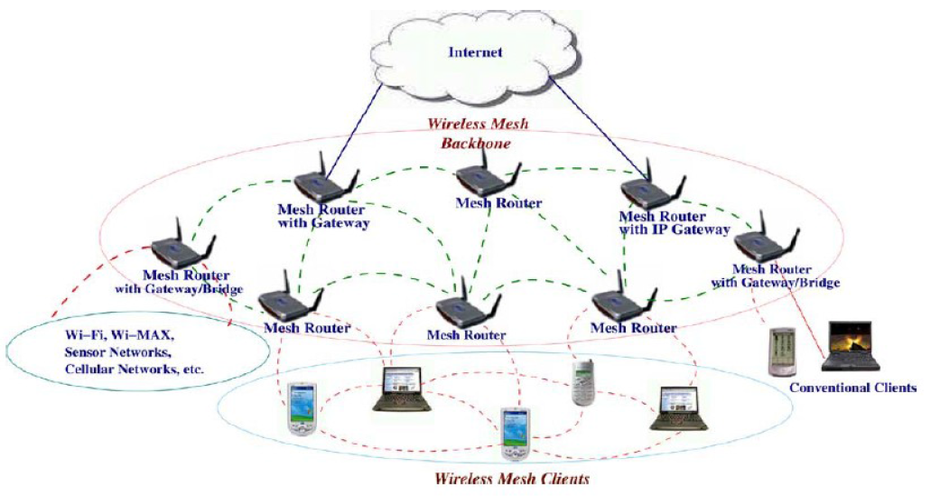
Hybrid WMNs

Slide 15
network comprises by both infrastructure and client mesh networks.
The clients can access the network by other clients or by routers providing improved connectivity and coverage within the WMN.

Slide 16
IEEE 802.11s ARCHITECTURE
802.11s is an amendment being developed to the IEEE 802.11 WLAN (Wireless Local Area Networks) standard.
802.11s Scope
802.11s WLAN Mesh Networking - Integrates mesh networking services and protocols with 802.11 at the MAC Layer

Slide 17
Primary Scope
Amendment to IEEE 802.11 to create a Wireless Distribution System with automatic topology learning and wireless path configuration
Small/medium mesh networks (~32 forwarding nodes) – can be larger.
Dynamic, radio-aware path selection in the mesh, enabling data delivery on single-hop and multi-hop paths (unicast and broadcast/multicast).
Extensible to allow support for diverse applications and future innovation.
Compatible with higher layer protocols

Slide 18
Network architecture

Slide 19
Mesh Point (MP): establishes peer links with MP neighbors, full participant in WLAN Mesh services.
Light Weight MP participates only in 1-hop communication with immediate neighbors (routing=NULL).
Mesh AP (MAP): functionality of a MP, collocated with AP which provides BSS services to support communication with STAs.
Mesh Portal (MPP): point at which MSDUs exit and enter a WLAN Mesh (relies on higher layer bridging functions).
MPPs is another type of MPs that has the ability of interconnecting other WMS with the network it belongs to.
Furthermore, it can act as a bridge/gateway of the mesh network and other networks in the DS.
Such a WMN is uniquely identified by a mesh ID assigned to every MP to represent an ESS.

Slide 20
Station (STA): outside of the WLAN Mesh, connected via Mesh AP.
The 802.11 defines an extended service set (ESS), usually referred to as a mesh network
Minimal MP operations
neighbor discovery, channel selection, and forming associations with neighbors
A WDS(Wireless Distributed System) is formed by MPs and mesh links that connect the MPs.

Slide 21
Medium Access Coordination Function

Slide 22
The sublayer is built on top of the PHY layer where no modifications have been made.
The 802.11s MAC sublayer is a modification to IEEE 802.11 to create a WDS.

Slide 23
Mesh Topology Learning, Routing and Forwarding
Focused on peer-to-peer discovery of MPs,
Service set(SS) enables automatic topology learning, establishes links and forms a dynamic data delivery path across MPs.
Topology discovery and formation:
A new candidate node initially gathers information from neighboring nodes either by active scanning (i.e. sending probe messages) or
by passive listening (i.e. by receiving periodic beacons).
Finally, two peers form a partial or a full mesh topology

Slide 24
Path selection protocol:
Path selection protocol is used to handle unicast and broadcast/multicast data delivery.
On the other hand, MPs might be mobile or non mobile.
A hybrid routing protocol supporting both proactive and non-demand schemes is more suitable for such a network.
Thus, the hybrid scheme uses the ad hoc on demand vector (AODV) and the optimized link state routing (OLSR) to reach the goal.
To make the routing protocols more robust against link failures, radio aware metrics are proposed.

Slide 25
Forwarding scheme:
The traffic in a WMN consists of 4-address data frames.
When a MP receives such frames, it checks for the frame authenticity and the destination MAC address before forwarding
In the MAP arrive the 3-address frame which is converted to a 4-address format and then it is forwarded to its destination.
The support of forwarding multicast and broadcast traffic is also supported.

Slide 26
Opportunistic Network/Routing
Routing used in WMN
In many mesh application environments, nodes form a disconnected networks due to
Node mobility,
node sparseness,
Lossy link of signal attenuation or
Shut-down the transmission to conserve energy and etc.
Traditional Internet routing/forwarding techniques are not available for WMN because they implicitly assume that the network, even if sparse, is connected and an end-to-end path always exists between any source-destination.

Slide 27
Mesh network
This category of ad hoc networks where diverse systems, join in dynamically to exploit the resources of separate networks according to the needs of specific application tasks.
Communication Opportunities (contact) are not continuous
Network is partitioned & No continuous end-to-end path

Slide 28
If different links come up and down, over time, due to occasional partial-connectivity or node mobility, the sequence of connectivity graphs over a time interval are overlapped, then an end-to-end path might exist
Here we need Store-Carry-Forward routing pattern.
A message could be sent over an existing link, get buffered at the next hop until the next link in the path comes up, and so on and so forth, until it reaches the final destination
Independent, local forwarding decisions, based on the current connectivity information and
possible prediction of future connectivity

Slide 29
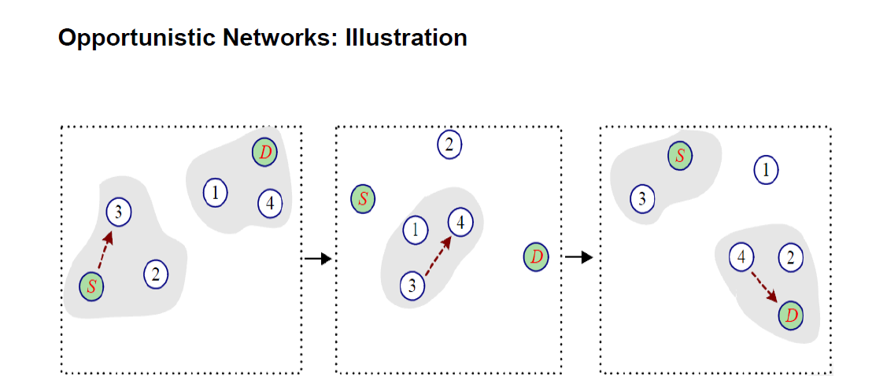

Slide 30
Routing categories :
Context information based
Geographical information based
Signal strength based
Infrastructure based
Hybrid strategy

Slide 31
OppNet Routing: Context information
The context in which the users communicate like:
Node mobility information
History of node behavior
Networks connectivity
Therefore, given context information about the destination, suitable forwarders could be chosen based on:
The probability of contact with other users
The probability of visiting particular places

Slide 32
Context-aware routing classification
Context-oblivious (Unaware)
Flooding-based
Message should be disseminated as widely as possible
The only solution when no context information is available
High Overload
To limit overload, possible techniques is to control flooding by
Limiting the number of copies
Limiting the number of hops
May suffer high contention and potentially lead to networks congestion

Slide 33
Examples
Epidemic routing
When two nodes meet, exchange summary vectors which contain with compact representation of the messages currently stored in their local buffers.
Good delivery rate and latency
Exhaustion of resources, storage management strategy is important
Spray & Wait
Spray phase: L copies of the same message are spread over the networks both by the source node and those nodes that have first received the message from the source itself
Wait phase: each node holding a copy of the message does nothing but simply store its copy and wait to eventually deliver it to the destination when it comes insides the range

Slide 34
2 Partially Context-aware Protocols
Evolution of Epidemic
During a contact, nodes also exchange their Delivery Predictability (DP) to destinations of the message they store in their buffers
Delivery Predictability (DP): Degree of meeting with destination
Messages are requested only if DP is higher than that of the node currently storing the message DP is the probability for a node to encounter certain destination
Increases when the node meets the destination
Decreases (according to an ageing function) between meetings
Spray & Focus
Improve the Wait phase of Spray & Wait, in Focus phase, each relay can forward its copy to a potentially more appropriate relay node

Slide 35
3. Fully Context-aware Protocols
Provide general mechanisms to handle and use context information
More general than Partial Context-Aware:
Works with any context information
Can be customized for the specific environment
Examples
PROPICMAN (Probabilistic Routing Protocol for Intermittently Connected Mobile Ad hoc Networks)
HiBOp (History-Based Opportunistic routing)
CAR (Context-aware Adaptive Routing)

Slide 36
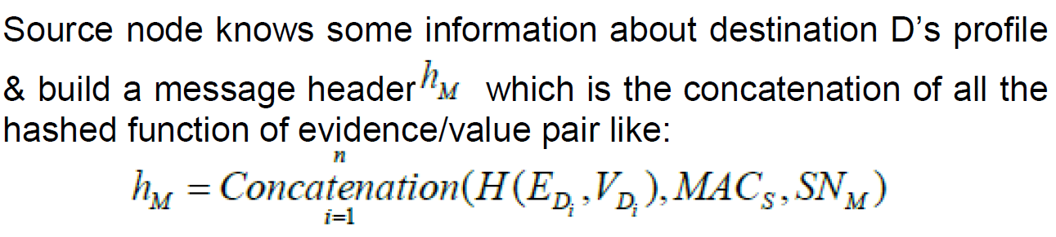
PROPICMAN
Exploit the context information of nodes to select the best next-hop candidate (e.g. work place, city, street, name, hobby, etc.)
Each node has a common Node Profile with evidence/value pairs, evidences have different weights

Slide 37
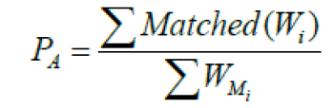
S sends to every neighbor node, without the original message content.
>Neighbor A compares the header pairs of evidence/value with its own hashed value.
>For each matching element, A gets the weight of that evidence.
From all the matching elements, the Delivery Probability of A is:

Slide 38
4. Fully Context-aware Protocols : (CAR)
Nodes are divided into partitions
Nodes inside the same partition are connected by an underlying proactive routing protocol (e.g. DSDV), each node has its own routing table.
The nodes located in the other partitions of the network are not reachable through classical routing protocol.
Focus on expanding the classical routing table to support forwarding across intermittently(some times)-connected ad hoc networks by adding a “Delivery Probability” item, to each “Destination –Best Forwarder” entry.
Each node produces its own delivery probability towards each known destination.

Slide 39
SELF CONFIGURATION / AUTO CONFIGURATION
The issues which affect their performance of any network include the following:
Distributed MAC & Multihop Communication
Because of the ‘decentralized’ nature of mesh networks, the MAC function should be accomplished in a distributed manner i.e. to establish multi-point to multi-point links between the mesh nodes
Moreover, the MAC protocol for WMNs needs to have multihop communications at the core of its design.

Slide 40
2. Mesh Routing:
Mesh networking requires each node to share route information with other nodes.
This functionality should be assured by the mesh routing protocol.
But ad-hoc routing protocols lack various important performance factors such as scalability, fault tolerance, fairness, load balancing.
In addition, certain areas such as mobility and power management have totally different requirements in ad-hoc networks and WMNs.

Slide 41
3 Application and Service Perspective:
Every application and service has its own inherent characteristics which makes it perform well on one platform and not on another.
Due to the distributed multihop features of mesh networks and the non significant support from the lower layers to assure certain quality of service support for the application layer, there is a pressing need to adapt the existing applications to WMN architecture.

Slide 42
4. Interoperability and Integration:
Due to the emergence and rapid growth of heterogeneous wireless access technologies such as WiFi, WiMAX, various cellular systems etc., interoperability and integration are a major concern for future wireless systems.
While WMNs can probably serve as a unifying technology for all these disparate systems, more research still needs to be performed to ensure that seamless service can be offered to users irrespective of access technology.

Slide 43
OVERVIEW OF WMN OPERATION
A wireless mesh network (WMN) is a communications network made up of radio nodes organized in a mesh topology.
The coverage area of the radio nodes working as a single network is sometimes called a mesh cloud.
Access to this mesh cloud is dependent on the radio nodes working in harmony with each other to create a radio network.
Typically, a mesh network is reliable and offers redundancy since links are typically "any to- any".
When one node can no longer operate, the rest of the nodes can still communicate with each other,

Slide 44
ASSUMPTIONS
Some key assumptions were made while developing this framework
Internet access occurs only via the mesh infrastructure nodes. These nodes are largely stationary or move very infrequently.
The subscription module (token or smartcard) used in the WMN devices is tamper-resistant. Any attempts to modify its contents results in a network notification.
IP address assignment is adaptable based on the network the node is allowed to join.

Slide 45
ASSUMPTIONS
The nodes used in the WMN are multi-channel, multi-radio nodes; Data and control packets can be sent out via either interface.
Self-healing should not trigger a re-configuration of the topology tree. It should use alternate links discovered during the discovery, bootstrapping and registration process. This will ensure long-term stability of the network's topology.
There is no need to design a routing protocol specifically for the network. Any routing protocol (proactive or reactive) should be able to work within the mesh.
The algorithm is both distributed and centralized.
The discovery, bootstrapping and registration process are distributed
While the centralized portion consists of agents running on the nodes reporting to a centralized manager with status on various network

Slide 46
i . NODE INITIALIZATION
Two general approaches that have been used for the development of MAC layer protocols in WMNs:
Single Channel MAC
Multiple Channel MAC
Each node have to decide which type of MAC it going to use

Slide 47
Single-channel MAC:
The single-channel MAC is the most pervasively deployed link layer scheme for wireless networks.
802.11 WLANs are based on the CSMA/CA protocol
Some Protocols for WMN are enhancements of the CSMA/CA protocol for WLAN.
Schemes in this category typically adjust parameters of CSMA/CA such as contention window size and modify back off procedures
To reduce the interference Two major schemes exist in this category :
MAC based on directional antenna and
MAC with power control.

Slide 48
MAC based on directional antenna
scheme relies heavily on advanced antenna technology to ensure that communication between nodes is as focused as possible to reduce interference.
MAC with power control.
Schemes utilizes power control to reduce interference.
This can help reduce exposed nodes problem (a node is prevented from sending packets to other nodes because of a neighboring transmitter), especially in a dense network, thereby improving spatial reuse in the network.
However, hidden nodes still exist and may become worse because lower transmission power level reduces the possibility of detecting a potential interfering node.

Slide 49
Multi-channel MAC:
A multi-channel MAC can be implemented on several different hardware platforms, which also impacts the design of the MAC.
The design can be based on a single transceiver or multiple transceivers.
With a single transceiver, only one channel can be active at a time.
M
ultiple nodes may operate on different channels to help boost network capacity.

Slide 50
Multi-radio MAC:
Here a network node has multiple radios(transceiver) each with its own MAC and physical layers.
A virtual MAC protocol such as the multi-radio unification protocol (MUP) is required on top of MAC to coordinate communications in all radio links and channels.
Although, one radio can have multiple channels, a single channel is used in each radio for simplicity of design and application.

Slide 51
How node Initialized
?

Slide 52
How node Initialized?
Assumption as all wireless mesh gateways (WMGs) are installed by the provider and are not likely to be moved.
The node initialization stage is for wireless mesh routers (WMRs) that are joining the network.
The WMR performs a hardware check to ensure that all its hardware is functioning properly.
It then starts sending out maintenance beacons (broadcast) every second at the base power level
Transmitting at the base power level helps ensure that the broadcasts do not impact the network unnecessarily.
They also help assure that any nodes that receive it are definitely within good transmission range of the WMR.

Slide 53
Beacon Contain
Enterprise Service Set ID (ESSID)
Wireless Channels (WCH). This indicates what channels have been assigned to the network.
Cipher of ESSID and Subscriber/Node ID encrypted with the Service Provider’s Private key.
Node Status (NSTAT) – Bridge (B), Gateway (G), Subscriber (S),
One-way hash of Node Status (Bridge, Gateway, Subscriber) and Subscriber/Node ID.
These beacons are forwarded all over the network till they arrive at a WMG which forwards them to the core provider network.
The core provider network contains the services that the network provides (authentication, authorization, accounting, billing, certificate services etc.)

Slide 54
Every WMR/WMG that receives this beacon sends a beacon back to the originating node (unicast).
The node trying to initialize keeps track of the beacons it receives.
If it receives a beacon from another node three times in succession (within specified time period), it stores the transmitting node in its neighborhood table.
If it receives a beacon from a WMG (as indicated by the node status) and verifies it by decrypting the cipher of the ESSID and NID

Slide 63
NODE BOOTSTRAPPING
ii

Slide 64
After the node initializes, it has to properly join the network topology.
This is especially important in wireless networks as the ability to sense a node does not necessarily mean it is best to communicate using that node.
This stage is known as node bootstrapping.
The node uses the information gained from the initialization stage (neighborhood list, RF properties etc.) for this stage.

Slide 65
Bootstrapping
As nodes receive and send beacons, the node gathers information about the topology network.
The node is able to establish its neighborhood and determine which nodes it can ‘hear’ clearly.
This achieves two objectives:
If all checks pass, it means the node is a valid member of the network and can be reasonably determined to be under the control of a valid subscriber.
If this is a guest node from a foreign network, the node still gets connected from a topology perspective but is not allowed to utilize any network services until the Network registration stage is complete

Slide 66
Bootstrapping
Each node sends out a summary report (broadcast) with all the nodes in its collision neighborhood to other nodes
Based of all the received reports, each node builds a subtree with itself as the root with paths chosen optimally.
Only nodes who lose paths will broadcast a new summary report which may or may not trigger path calculations at other nodes

Slide 67
CAPACITY MODELS

Slide 68
Capacity
The capacity of a multi-hop wireless network is the traffic payload that it can transport
Two complementary definitions
Network-wise capacity: It is a measurement of the behavior of the whole network. It is defined as the sum of the traffics that have reached the gateways to the Internet.
Flow-wise capacity, measures the capacity of each flow, that is the quantity of bandwidth allocated to the traffic collected by each router.

Slide 69
Routing protocols
Four routing protocols in order to route the upload traffic from the routers to the gateways.
Shortest path routing
This routing protocol is based on the Dijkstra algorithm.
The goal is to find the shortest path in terms of hops between source and destination.
Geographic routing protocol
This routing protocol is based on the knowledge of geographic position for each node using GPS-like positioning.
The main idea is to compare, at each hop, the Euclidean distance between all neighbors and the destination, and choose to forward the packet to the closest neighbor.

Slide 70
Random routing protocol
This routing is based on a random walk. It means that at each hop, the packet is forwarded to a randomly chosen neighbor.
This protocol does not require the knowledge of the whole network, but only the neighborhood of each router
a packet is never routed to a node which has no other neighbor
Static routing protocol
With this routing protocol, all the paths between source node and destination are manually entered.
This protocol does not require the use of control packets.

Slide 71
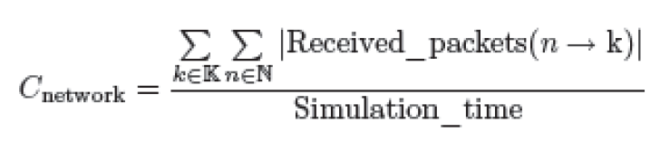
Performance evaluation criteria
Network capacity
the network-wise capacity is the quantity of traffic sent by all nodes (N) and forwarded to the Internet through the gateways (K) during the simulation period.
It is a view of the global bandwidth of the network shared among all nodes.
This metric represents the maximum quantity of traffic that the network can transmit to the Internet.

Slide 72
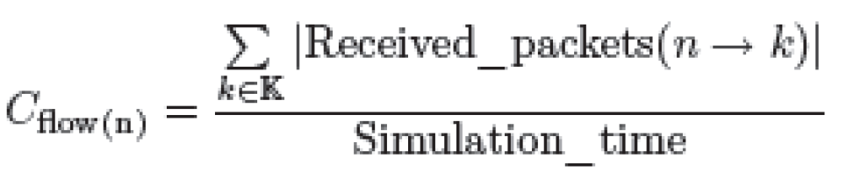
Performance evaluation criteria
Flow capacity
It is defined by the sum of traffics sent by a router and received by the gateway
This metric illustrates the bandwidth consumed by each router in the network.
This metric is calculated as follows.

Slide 73
Capacity Problems
Efficient use suggests multi-channel routing
Approaches
Multi-channel, one radio
Cheaper
Switching delay
Same (or worse) delay as single-channel in a given hop
But better over multiple hops
Multi-channel, multi-radio
More radios: more expensive
But still relatively cheap
But they interfere with each other
Use one in 2.4 GHz and one in 5 GHz band

Slide 74
HETEROGENEOUS MESH NETWORK

Slide 75
HETEROGENEOUS MESH NETWORK
Heterogeneous mesh network is the combination of different types of mesh networks to improve the performance of the network.
The major obstacles of large Wi-Fi mesh network include
low capacity,
limited system performance, and
the uncertainty of mesh topologies
and wireless link quality.

Slide 76
Reason for the obstacles
1
Multihop transmission is one of the major reasons that limit the system performance.
The performance of multihop transmission decreases quickly as the number of hops increases.
Packets that traverse through more hops either have little opportunity to reach the destination, or consume too much network resource, both of which decrease the system capacity and increase delay and congestion.
2
Due to network topology and link or node failures, some mesh nodes (known as island nodes) may fail to find available paths .
Depending on specific topologies and failure probabilities, the proportion of island nodes may not be negligible

Slide 77
3
In large mesh networks, centralized MAC layer schemes, global link transmission scheduling, or synchronization are not practical.
Therefore, hidden terminals could cause collisions and further reduce the capacity
4
Because of the traffic dynamics, Wi-Fi mesh network is prone to network congestions and congested links negatively influence the performance of mesh networks.

Slide 78
Need for use Wi-Fi with WiMAX Networks Mesh Network
WiMAX use line of sight transmission
With less frequency waves it can be used in outdoor and indoor
However, large-scale wide-area meshes may not be efficient and cost- effective if we use only WiMAX
1
although the large coverage of WiMAX reduces the number of wireless hops in the network, it cannot support good spatial-reuse of spectrum;
while Wi-Fi has been proven to be a good solution.
2
WiMAX devices have much higher power consumption and
more expensive than Wi-Fi devices

Slide 79
Need for Hybrid Wi-Fi/WiMAX Networks Mesh Network
3
from the economical aspect, Wi- Fi devices have been widely deployed, and therefore it is beneficial to integrate WiMAX networks with existing Wi-Fi networks.
Advantages of Hybird wifi, wimax
The deep penetration of Wi-Fi networks provides good throughput and large coverage at low cost.
The long range transmission of WiMAX can effectively solve the major problems in large Wi-Fi mesh networks.
The presence of WiMAX networks alleviates the need to transmit over a large number of hops
Far-away nodes can forward traffic through WiMAX networks, while traffic generated by the nodes near portals still go through Wi-Fi.

Slide 80
Advantages of Hybird wifi, wimax
A good proportion of multihop wireless transmissions are replaced by one-hop wireless transmission through WiMAX.
The exposed terminals would also become less severe with shorter paths of WiFi. Second, island nodes with dual interfaces can connect to WiMAX, and thus network coverage is improved.
WiMAX and Wi-Fi networks is that they can coexist without interference as long as they operate on different spectrums.

Slide 81
Architecture
There are three kinds of nodes,
customer terminals such as laptops, PDAs and smart cell phones,
mesh nodes such as APs and laptops with routing function, and
WiMAX base stations (WMBS).
Customer terminals have only Wi-Fi interfaces and send packets to the nearby mesh nodes;
mesh nodes could either have only Wi-Fi or both wifi and wimax
WMBSs only have WiMAX interfaces

Slide 82
Here three kinds of wireless connections exist
customer terminals-mesh nodes,
mesh nodes-mesh nodes, and
mesh nodes-WMBSs.
First to can use wifi connection, with multi channel / multi radio connection
The internet portal and WMBS are connected with wired connection

Slide 83
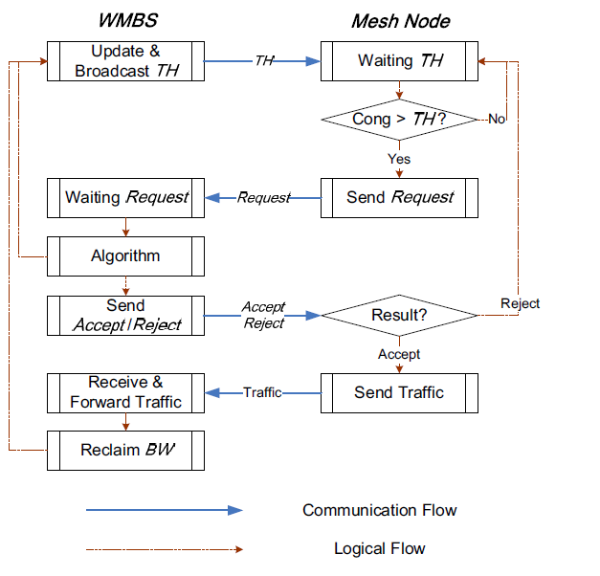
PROTOCOL AND ALGORITHM DESIGN
we focus on the cooperation between the WiFi and the WiMAX networks, and introduce load balancing protocol in the heterogeneous network (LABHW).
LABHW is shown in Figure

Slide 84
The WMBS broadcasts ’Threshold’ (TH) to all Wi-Fi nodes when TH gets updated.
TH is the reference for all mesh nodes to compare their local congestion situations with the global one.
When a mesh node, say node a, receives a new TH from the WMBS, it updates its local THa.
Node a compares its current local utilization Cong_{a} with the latest TH it has received from WMBS.
If Cong_{a} exceeds TH_{a}, node a sends a Request to the WMBS.
Once a new Request from node a arrives, the WMBS decides whether node a can send traffic to the WiMAX network and the amount of the WiMAX bandwidth assigned to it, WBWa
If there is not enough WiMAX bandwidth, or node a sends a faulty Request due to non-latest THa, the WMBS sends Reject to node a; otherwise, the WMBS sends Accept

Slide 85
Once node a acquires Accept, it sends the traffic to the WMBS with the transmission rate limit WBWa; while the WMBS receives and forwards the traffic to the destination.
When the WMBS finishes forwarding flows from node a, it reclaims the WiMAX bandwidth, and updates and broadcasts the new TH.

Slide 86
VEHICULAR MESH NETWORK

Slide 87
Vehicular communication has mainly focused on supporting two broad categories of applications:
a) vehicular safety, such as exchanging safety relevant information or remote diagnostics using data from sensors built into vehicles
b) mobile internet access. However, there is a large untapped potential of using such vehicular networks as powerful and distributed computing or as transit networks.

Slide 88
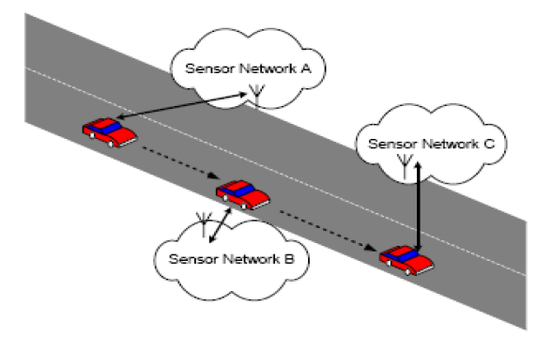
Using VMesh to connect disjoint sensor networks
VMesh can be used to interconnect the sensors and the backbone wide area network (WAN) infrastructure, e.g., Internet backbone, wireless cellular infrastructure etc

Slide 89
Properties and Design Challenges
First, vehicles travel at a much higher speed, making it challenging to sustain communications between stationary sites and moving vehicles, as well as handing-off the communication link from one site to the other as the vehicles pass between them.
Second, despite the common assumption of random mobility patterns in many simulation studies on ad hoc networks, the vehicular traffic has a more well defined structure that depends on the transportation grid
Lastly, vehicles, as communication nodes, have rich life and computing power as compared to sensor networks.

Slide 90
VMesh goals:
Low Deployment and Maintenance Cost:
Since the routers in this case are ”mobile”, one can drive these mobile routers into a station for repairs or software/hardware upgrades, instead of having to end a repair team out to various locations to fix the problems if they were stationary.
Moreover, the number of mobile routers required can be minimized, e.g., using buses traveling on different routes is sufficient to cover the entire city.
Hence, both the installation and maintenance costs are greatly reduced.

Slide 91
VMesh goals:
Adaptive Fidelity:
By using a combination of vehicles as mobile routers, Vmesh provides a wide spectrum of flexibility in terms of the frequency of message retrieving
For example, while buses run every 0.5 - 1 hour, they do not stop at every single household.
On the other hand, garbage trucks may stop at every household but they only come by once a week.

Slide 92
Scalability:
VMesh can support incremental deployment easily as the number of sensor nodes grows.
Broadcast and Multicast Capabilities:
Broadcast and multicast capabilities are inherent in the wireless communications used
between the mobile routers and sensor nodes,
between the mobile routers and aggregation points to the VMesh network backbone, and
between mobile routers and other vehicles equipped with wireless transceivers.

Slide 93
High Level of Redundancy:
VMesh has a high level of built-in redundancy by leveraging different vehicles that overlap in spatial coverage
The same end-user can be connected by two or three different types of vehicles.
There are multiple available paths to ensure the delivery of the demand response messages.
Failure Resiliency via Deflection Routing:
VMesh ensures the survivability of the DR messages by deploying the deflection routing technique.
The key premise lies in the ability of VMesh to deflect messages until a valid path is found to the destination instead of dropping them when the original path fails due to faulty mobile routers, broken communication links, or vehicular accidents.

Slide 94
VMESH ARCHITECTURE
Vehicular mesh networks are ad hoc networks formed by vehicles enabled with wireless networking.
As the vehicles move, the connectivity between the vehicles and other static network nodes changes.
The network is dynamic and as a result, nodes may be disconnected from the network at times.
To address this, nodes will store the data during the period they are disconnected from the network.

Slide 95
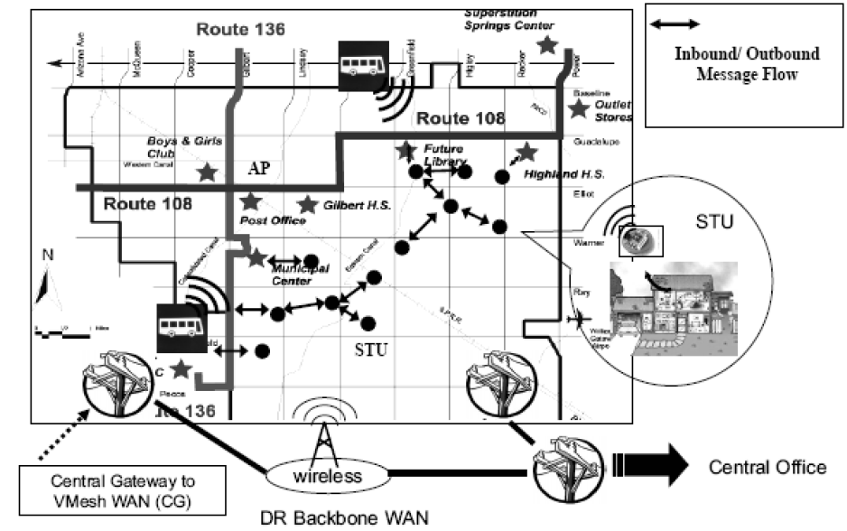

Slide 96
Sensing and Transceiving Units (STUs) are wireless enabled sensors that will transmit collected data to the central office (inbound message).
They also receive new configurations generated by the central office (outbound message).
These are shown as solid circles in Figure.
If STUs cannot directly connect to the VMesh backbone network, they can form a network themselves to route inbound and outbound messages.

Slide 97
Aggregation Points (APs) are nodes that act as gateways to the VMesh.
They can aggregate inbound messages, accept outbound messages, and route these outbound messages to one or more STUs.
These gateways could be special nodes deployed at appropriate locations or specific STUs that are enabled with the gateway functionality.

Slide 98
Mobile Routers (MRs) are wireless enabled mobile objects that have the ability to store and forward data.
For example, buses, along with other various types of vehicles equipped with storage and wireless networking, form ad hoc networks with other mobile routers and connect to the static gateways.
Central Gateways to VMesh (CGs) are gateways which connect different Vmesh networks.
These are located at specific locations on the paths of mobile routers, such as at the main terminal stop of buses.

Slide 99
ROUTING IN VMESH
The Greedy Perimeter Stateless Routing (GPSR) as the backbone algorithm to send data from sensors to APs.
In GPSR, need to establish a planar network, such as a Gabriel Graph (GG) or Related Neighborhood Graph (RNG) to eliminate intersecting edges in the network.
After that, two routing algorithms, greedy forwarding and perimeter routing, are used to deliver packets.
GPSR uses the most forwards within radius (MFR) greedy algorithm as the general packet forwarding algorithm to minimize hop counts.

